Slide 1


Introduction to CSS
By: Dalia Ihab

Slide 2


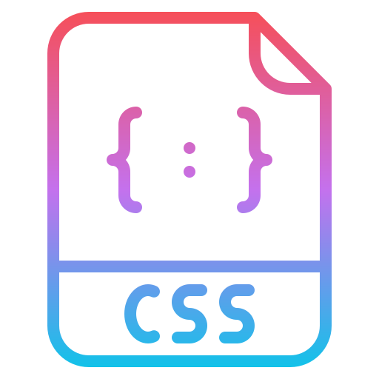
What is CSS ?
CSS (Cascading Style Sheets)is used to apply styles to web pages. Cascading Style Sheets are fondly referred to as CSS. It is used to make web pages presentable. The reason for using this is to simplify the process of making web pages presentable. I

Slide 3
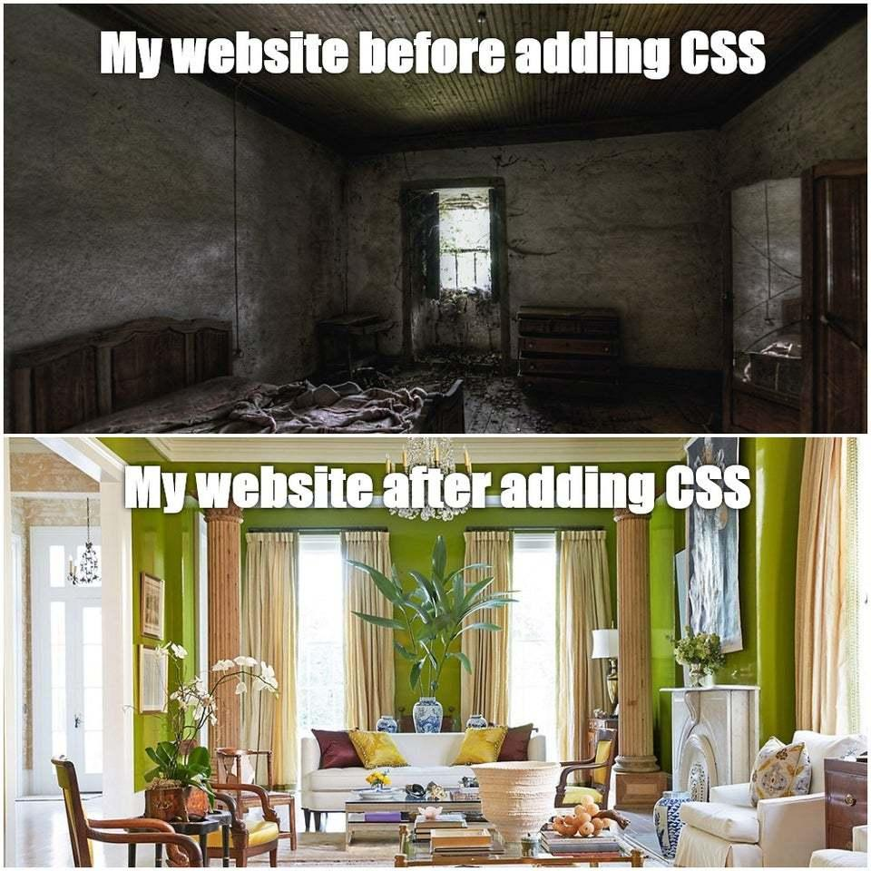

Slide 4
Most Terrible Websites
https://www.elegantthemes.com/blog/resources/bad-web-design-a-look-at-the-most-hilariously-terrible-websites-from-around-the-web

Slide 5

CSS Syntax

Slide 6
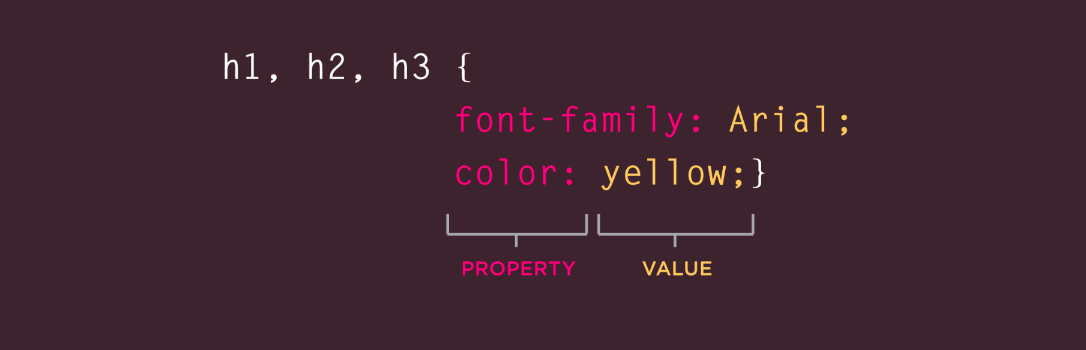
CSS Syntax

Slide 7


Next
Adding CSS to Our Website

